Slide 1
OOPS ASSESSMENT
Student Guidelines

Slide 2
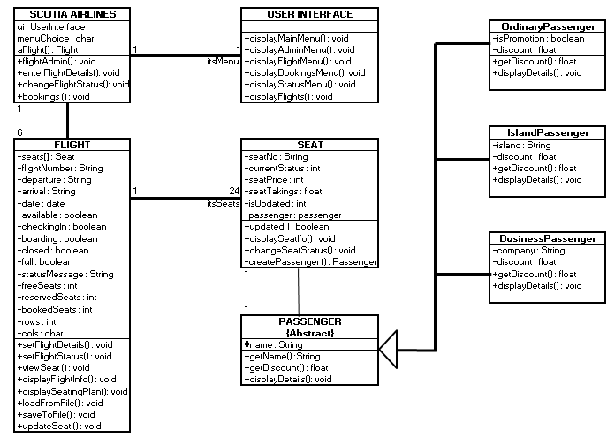
Main driver

Slide 3
Phase 1
Create the appropriate class definitions
Create a PassengerTestDriver to test
Record all tests on the test log sheets

Slide 4
Phase 2
Create the appropriate class definitions
Create a SeatTestDriver to test
Record all tests on the test log sheets
Remember – you will probably need to add additional methods to the underpinning classes

Slide 5
Phase 3
Create the appropriate class definitions
Create a FlightTestDriver to test
Record all tests on the test log sheets
Remember – you will probably need to add additional methods to the underpinning classes

Slide 6
These could be joined
Phase 4
Create the appropriate class definitions
Create develop the main driver class
Record all tests on the test log sheets
Remember – you will probably need to add additional methods to the underpinning classes

Slide 7
Outcome 1, Outcome 2
Specifically, the following features must be demonstrated in the candidate’s program listing:
Class and instance variables are appropriately defined, declared and initialised. At least one class must be abstract.
Arithmetic or logical operators are correctly used
Appropriate mathematical, character, or date (or time) functions are correctly used
Control structures, sequence, selection and iteration are correctly used
Use of object oriented programming concepts
Constructors are correctly used
Encapsulation is correctly used
Inheritance and polymorphism are correctly used
Correct use of visibility – public, private and protected variables and methods
Message passing is correctly used
Appropriate parameter passing is correctly used
Modules are internally documented to organisational standards
Appropriate error and contingency handling requirements are correctly used.
COMPLETION OF THE PROGRAM

Slide 8
Outcome 3
Test the completed product
Implementing a test plan using a defined strategy
Maintaining a test documentation (use the pro-forma provided)
Include the individual test driver classes
Evaluating results of test runs (comments)
Amending coding as necessary
Use the test drivers as the basis for your test logs. Make sure that the logs are complete. You will need to create a test log for:
Passenger
Seat
Flight
Airline
See Test Log.docx

Slide 9
Date | Friday 19th February | Anticipated grading
Class completed | Passenger Ordinary Island Business Passenger Driver (containing main()) Completed Test Strategy Completed Test Log (for above classes) | SQA – PASS Grading applied to dates
Date | Friday 5th March
Class completed | Seat Seat Driver (containing main()) Completed Test Log (for above classes) | SQA – PASS Grading applied to dates
Date | Friday 2nd April
Class completed | Flight (excluding MySQL connections) Flight Driver (containing main()) Completed Test Log (for above classes) | SQA – PASS
Date | Friday 30th April
Class completed | Flight (with MySQL connections) Flight Driver (containing main()) Completed Test Log (for above classes) | SQA – N/A Grading A if using UPDATE B if using DELETE and INSERT
Date | Friday 21st May
Class completed | Aircraft Aircraft Driver (containing main()) Completed Test Log (for above classes) | SQA – N/A Grading – A

